Slide 1
SQL Data Analyst Project
By Ashish

Slide 2
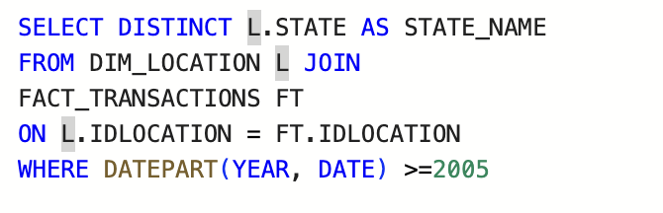
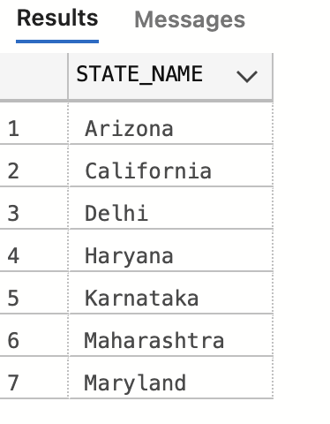
List all the states in which we have customers who
have bought cellphones from 2005 till today.
Query:
Output:

Slide 3
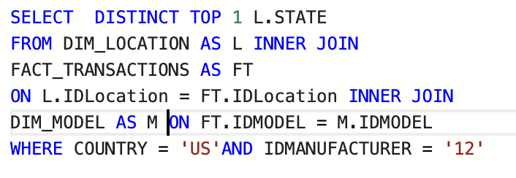
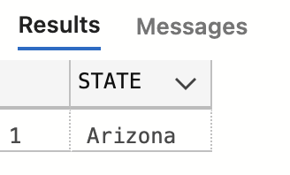
2. What state in the US is buying the most 'Samsung' cell phones?
Query:
Output:

Slide 4
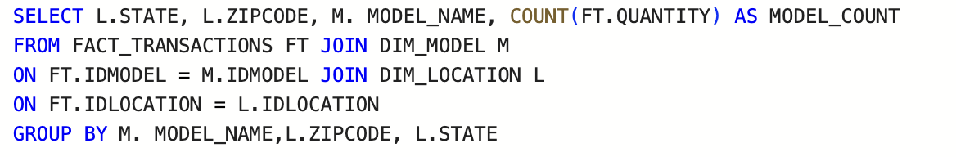
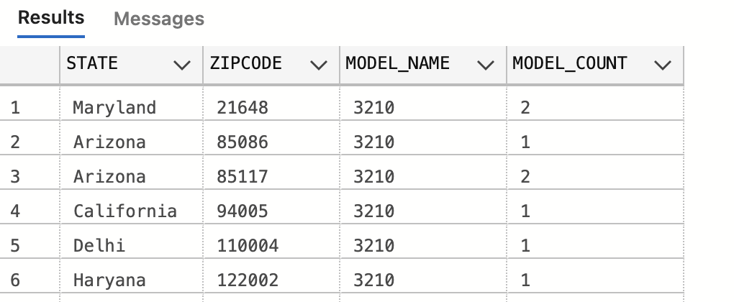
3. Show the number of transactions for each
model per zip code per state.
Query:
Output:

Slide 5
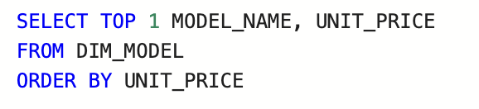
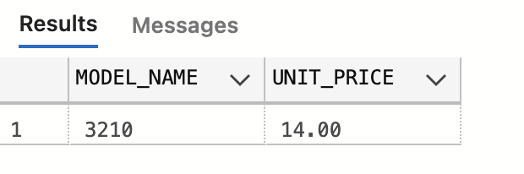
4. Show the cheapest cellphone (Output should contain the price also)
Query:
Output:

Slide 6
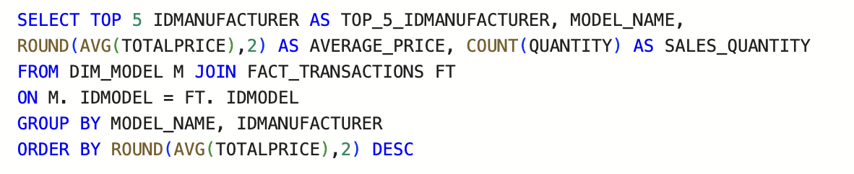
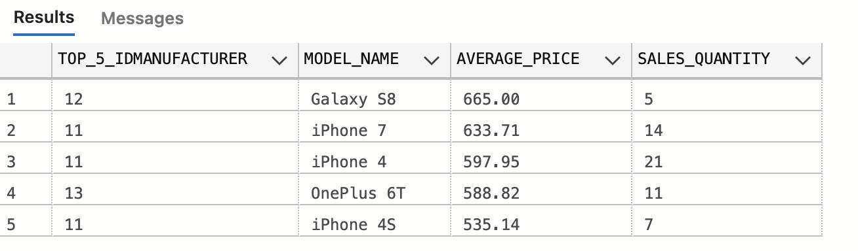
5. Find out the average price for each model in
the top 5 manufacturers in terms of sales
quantity and order by average price.
Query:
Output:

Slide 7
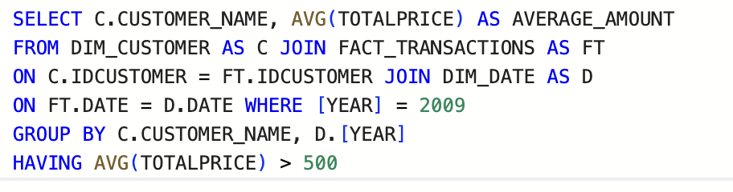
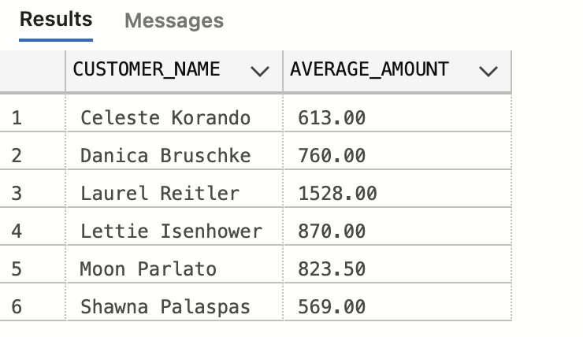
6. List the names of the customers and the average amount
spent in 2009, where the average is higher than 500
Query:
Output:

Slide 8
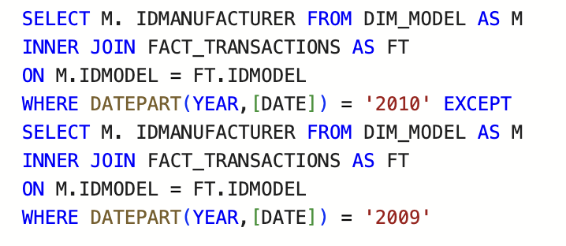
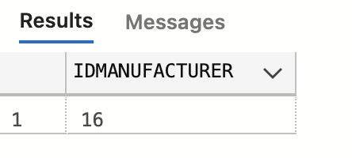
7. Show the manufacturers that sold cellphones in 2010 but did not in 2009.
Query:
Output:

Slide 9
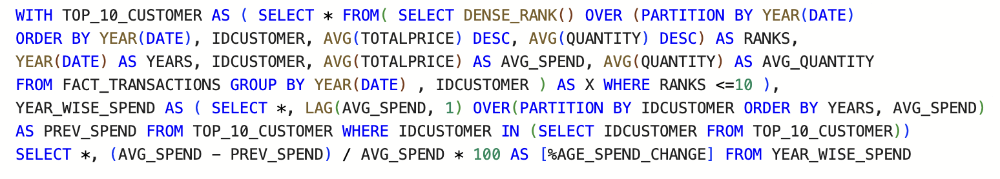
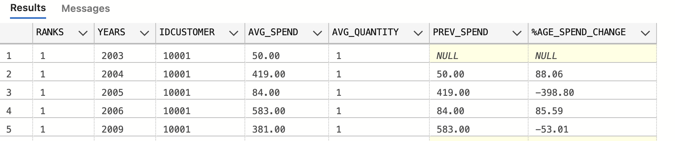
8. Find top 10 customers and their average spend,
average quantity by each year. Also find the
percentage of change in their spend.
Query:
Output:

Slide 10
THANK YOU

